Slide 1
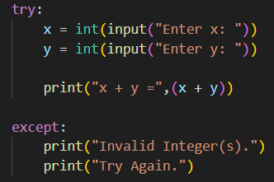
Error Handling
Handling Exceptions
Try Statement:
It comes before the block of statements that may cause the exception. If no exception occurs the code is executed normally. However, if an exception occurs, execution stops immediately and jumps to the except block.
Except Statement:
It follows the try block. If an exception occurs in the try block, execution immediately jumps to the except block. However, if no exception occurs, the statements in the except block are not executed at all
Group 7
Once the exception is handled, execution will continue with the next statement immediately following the try/except statements and the program will not crash.

Slide 2
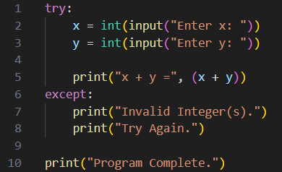
Handling Exceptions
Error Handling
Group 7
When a runtime error occurs while executing a Python program, an exception is raised. If the exception is not handled, it will ultimately crash the program.
Try Statement:
It comes before the block of statements that may cause the exception. If no exception occurs the code is executed normally. However, if an exception occurs, execution stops immediately and jumps to the except block.
Except Statement:
It follows the try block. If an exception occurs in the try block, execution immediately jumps to the except block. However, if no exception occurs, the statements in the except block are not executed at all
Once the exception is handled, execution will continue with the next statement immediately following the try/except statements and the program will not crash.

Slide 3
Closer Look at try/except Statements
Types of Errors
By Mohammed Baahir Yusuf
Try statement begins a block of code in which an exception may occur.
If an exception occurs anywhere in the try block, execution immediately jumps to the except block.
If no exception occurs at any point.
Then the statements in the except block are executed.
The statements in the except block are skipped entirely.
Then execution continues with statements after the except block.

Slide 4
Types of Errors
Closer Look at try/except Statements
Try statement begins a block of code in which an exception may occur.
If an exception occurs anywhere in the try block, execution immediately jumps to the except block.
If no exception occurs at any point.
Then the statements in the except block are executed.
The statements in the except block are skipped entirely.
By Mohammed Baahir Yusuf
Then execution continues with statements after the except block.

Slide 5
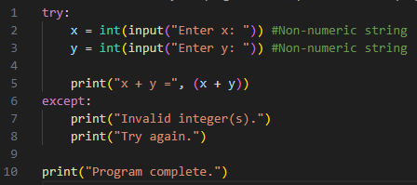
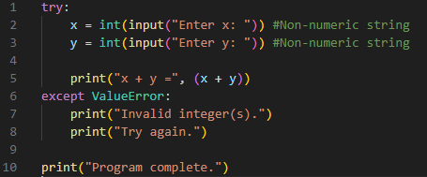
Introduction - Except statement
●While an except statement by itself will catch any kind of error, it is often that case that different errors should be treated differently.
Types of Errors
Method -1
Method-2
By Mohammed Baahir Yusuf

Slide 6
Introduction - Except statement
●Method-2 is best because - Each except statement may specify a specific type of error that it handles, meaning that different errors can be handled in different ways
Method -1
Method-2

Slide 7
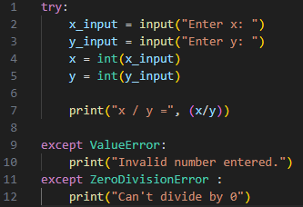
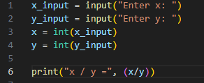
Types of Errors
Example:

Slide 8
Types of Errors
● An except statement may indicate the specific type of error it can handle.
There are many different types of errors in Python, some of which include:
FileNotFoundError : indicates that an operation was attempted on a file that does not exist.
E.g. open(“notafile.txt”)
TypeError : when trying to use a Python type incorrectly
E.g. x = 5, print(x[4]) ; . trying to use an index with an integer.
ValueError: a value of the wrong type was used .
E.g. int(“abc”) ; trying to cast “abc” –(Non-numerical/Alphanumeric string) into an integer.
Arithmetic Error: indicates some kind of arithmetic problem
E.g. ZeroDivisionError

Slide 9
Let’s live code!
●Create an “activities” module and add a new function named “numbers” that uses a loop to prompt the user to enter a filename. For each filename:
○Use a with/as statement to open the file.
○Calculate and print the sum of all of the numbers in the file (one per line).
●Terminate the loop when the user enters the empty string.
○Challenge: Print the sum of all of the numbers in all of the files.
○Use try/except statements
●There are at least two different kinds of errors that can occur when you call your numbers function:
○Passing a non-numeric value into the int() function causes a ValueError.
Trying to read a file that does not exist causes a FileNotFoundError.

Slide 10
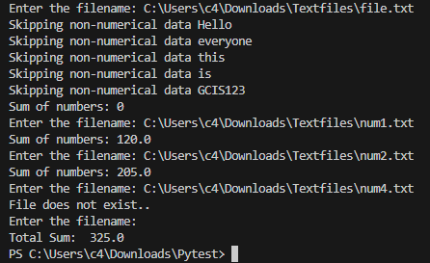
Output:

Slide 11
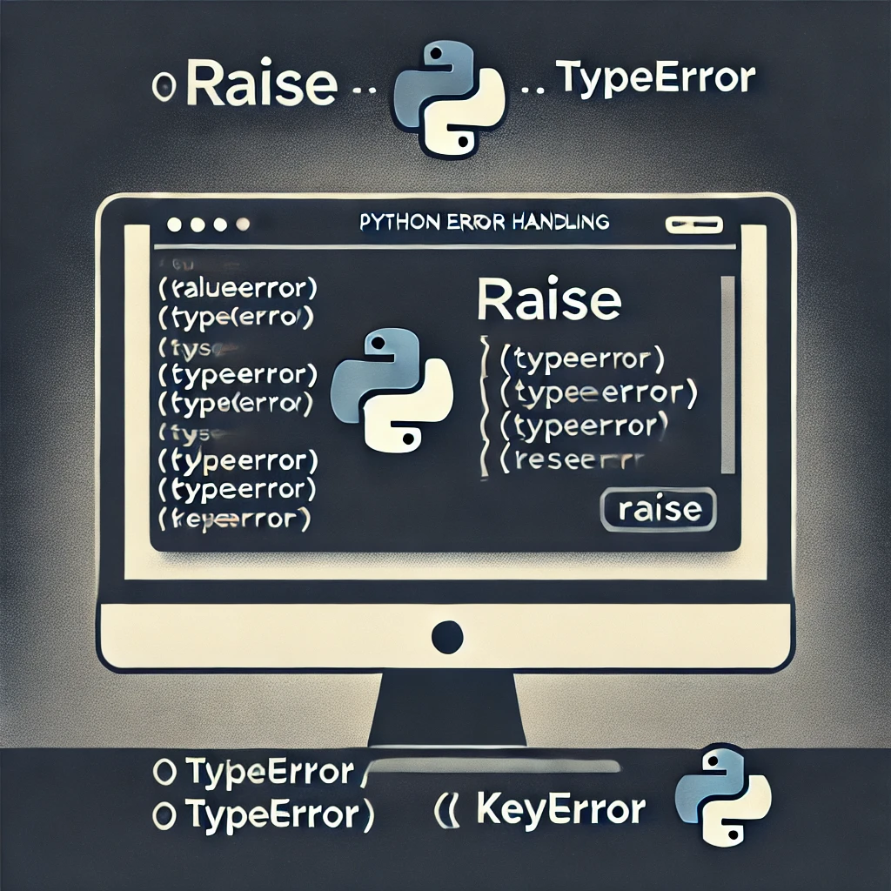
Raising Errors
Why?
To stop a program as you might want to catch an error early and raise it before it reaches any operations to save time on running the code.
Let’s look at a few examples where we might want to raise errors

Slide 12
Questions?
Closer Look at try/except Statements
Try statement begins a block of code in which an exception may occur.
If an exception occurs anywhere in the try block, execution immediately jumps to the except block.
If no exception occurs at any point.
Then the statements in the except block are executed.
The statements in the except block are skipped entirely.
Then execution continues with statements after the except block.

